Slide 1
Sandhya.R [ 152997 ] Team-2 Training Room 4 Capgemini MIPL Chennai

Slide 2
CAPSTORE APPLICATION

Slide 3
Modules Assigned
Password Encryption
Forget Password

Slide 4

Password Encryption:
During registration, the customer enters the password of their choice.
Password is checked with the validation constraints.
If it satisfies the constraints, then password is encrypted and stored in the database.
Tables to be interacted are customer and merchant.
Click to insert section title
Notes:
O Logo de espadas deve ter mais espaço das pontas abaixo. Sugerir outros tipos de imagens/ telefone, fones.

Slide 5
Forgot Password:
During login, if customer forgets the password, they can click forgot password.
Customer will be navigated to the page where he has to enter email id.
Upon verification of email, encrypted password will be sent through link.
Tables to be interacted are customer and merchant.
Click to insert section title
Notes:
O Logo de espadas deve ter mais espaço das pontas abaixo. Sugerir outros tipos de imagens/ telefone, fones.

Slide 6

Tables used
Customer
Merchant
Customer Id
Name
Phone Number
Email Id
DOB
Password
Is Active
Last Login
Merchant Id
Name
Company Name
Email Id
Password
Status
Phone Number
Is Active
Is Certified
Notes:
Otimo.
Mas eles acham que talvez a forma verde va conflitar se eles mudarem o logo espada para cima do lado direito.

Slide 7
Tables :
Customer Table
Column Name | Data type | Constraint | Description
customerId | int | Primary key Auto Generated | Used for unique identification
customerName | varchar | NotNull
phoneNumber | int | NotNull
emailId | varchar | unique | Will be Used for user Login
Dob | Date | NotNull
Password | Varchar | NotNull | Authentication purposes
Address | varchar | Foreign Key
Status | Varchar | NotNull | To let know if user is active or not
Notes:
Fixar a posicao do titulo – sempre do lado esquerdo.
Sempre que tiver muito texto o coluna deve sempre ser “ narrowed” , se nao fica dificil de ler. Colocar paragrafos no texto.
Linha vertical deve ser mais fina e as pontas NUNCA devem ser arredondadas.

Slide 8
Merchant Table
Column Name | Data type | Constraint | Description
merchantId | int | Primary key Auto Generated | Used for unique identification
merchantName | varchar | NotNull
phoneNumber | int | NotNull
emailId | varchar | unique | Will be Used for merchant Login
companyName | varchar | NotNull
Password | Varchar | NotNull | Authentication purposes
Address | varchar | Foreign Key
Status | Varchar | NotNull | To let know if user is active or not
isCertified | Boolean | NotNull | Is the Merchant CapStore Certified or Not
isValidated | Boolean | NotNull | Is the Merchant CapStore validated by admin or not
Notes:
Fixar a posicao do titulo – sempre do lado esquerdo.
Sempre que tiver muito texto o coluna deve sempre ser “ narrowed” , se nao fica dificil de ler. Colocar paragrafos no texto.
Linha vertical deve ser mais fina e as pontas NUNCA devem ser arredondadas.

Slide 9
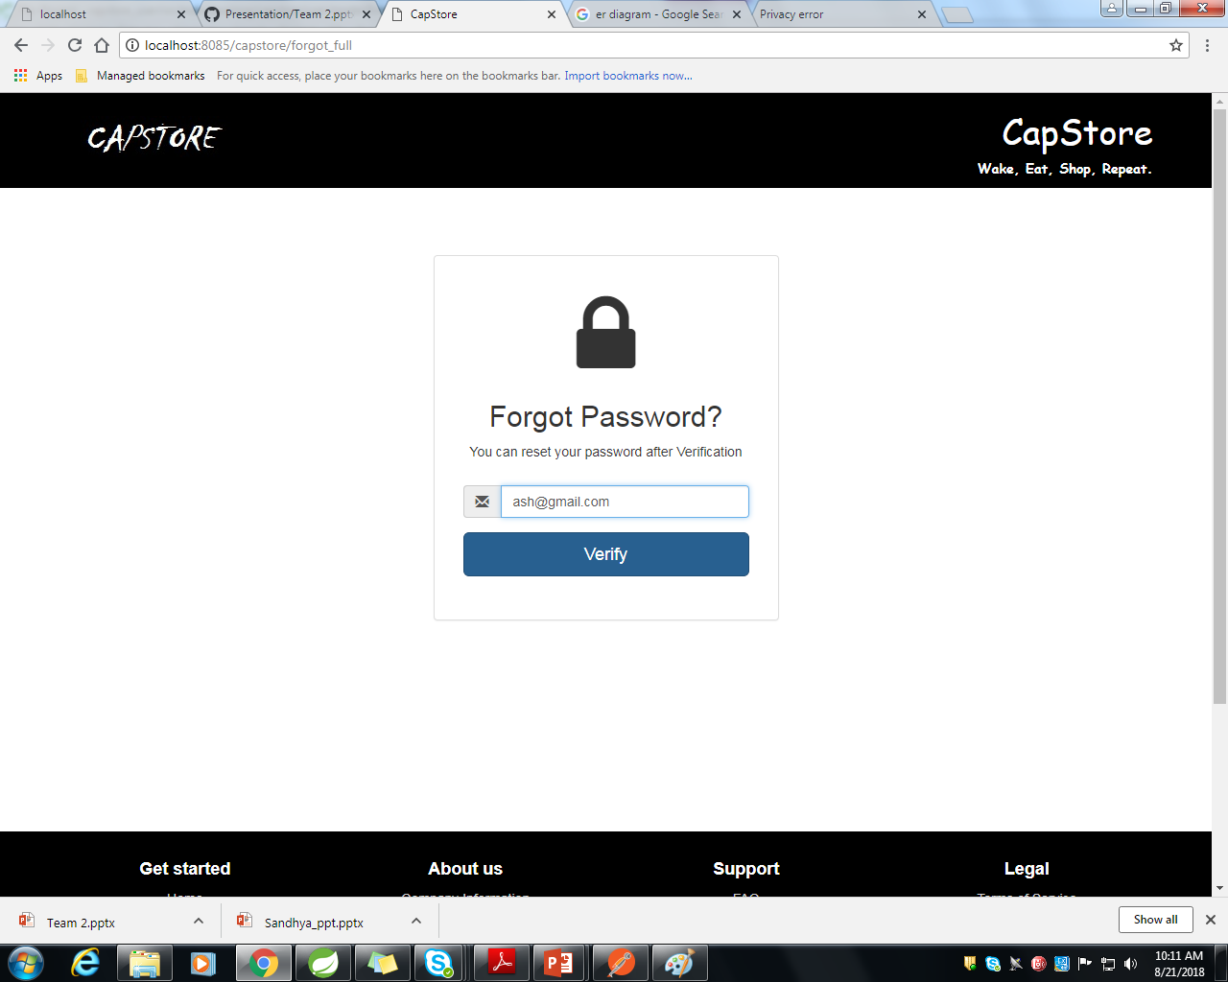
Forgot Password Page
When user clicks on forgot password link, he will be navigated to Email Verification Page.
1
Valid Email address should be given and it will be verified in database.
2
Upon verification, user will be navigated to password link page
3

Slide 10
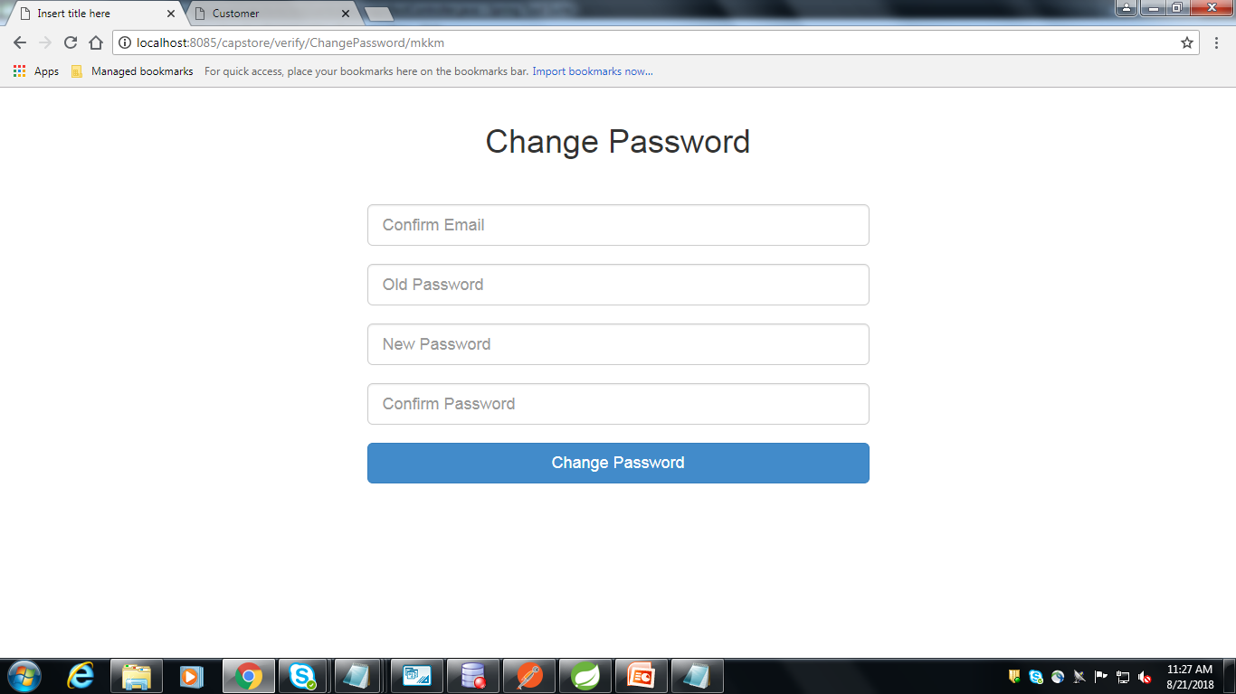
Encrypted Password Page
.

Slide 11
THANK YOU

